Slide 1



Data-Driven Storytelling Presentation: Unleashing Growth Potential: Unveiling Sales Insights for Strategic Action

Slide 2
Ignite Sales Excellence: Unleashing the Power of Data!
In today's hypercompetitive market, data is the key that unlocks doors to unprecedented growth and success.
In this presentation we dive into the depths of our sales analytics, uncover hidden patterns, and empower our team with data-driven insights. Get ready to ignite sales excellence and leave our competition in the dust!

Slide 3
Key Points and Ideas:
Sales Performance: The analysis of unit sales data across different account types reveals significant variations in performance. The data indicates that some accounts have shown remarkable growth, while others have experienced stagnant or declining sales.
Opportunities for Improvement: By focusing on the worst-performing accounts based on 5-year Compound Annual Growth Rate (CAGR), we can identify specific areas that require attention and improvement. These accounts hold untapped potential for growth and should be targeted for strategic intervention.
Operational Focus: Examining the product lines, marketing/promotion programs, and sales volumes provides valuable insights into successful strategies and areas for optimization. For instance, we can identify which product lines have been driving the most sales and which marketing programs have yielded the best results.

Slide 4
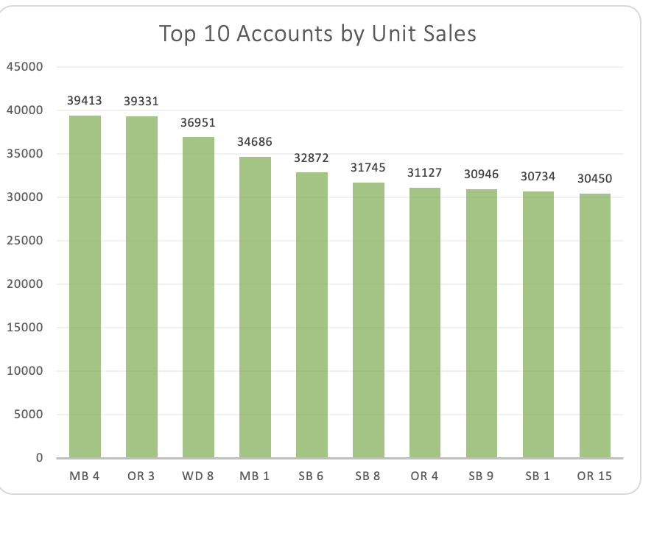
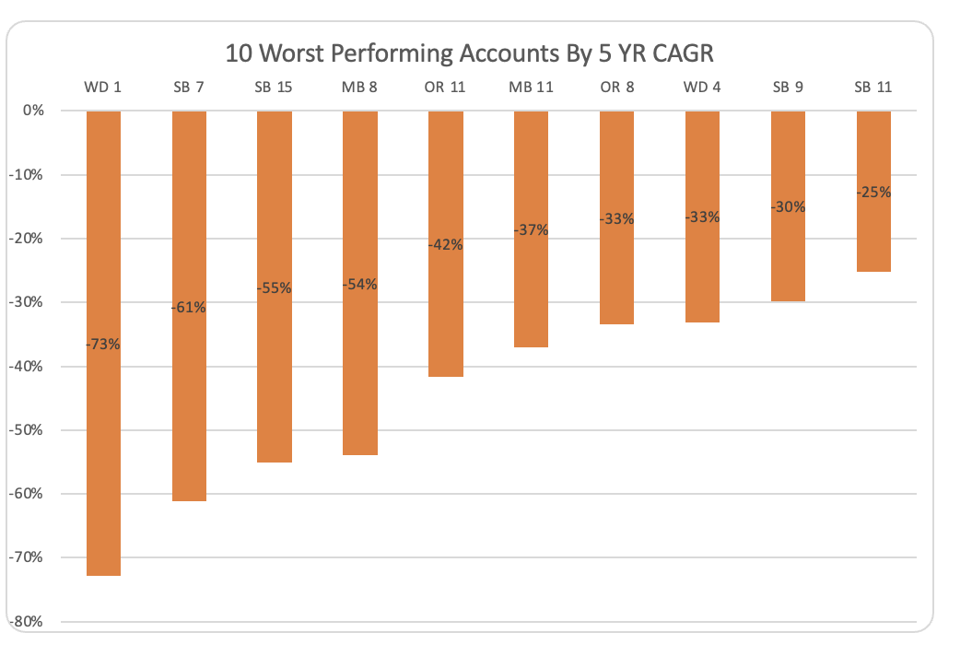
Explanation and Recommendations:
Top 10 Accounts by Unit Sales: These accounts have demonstrated high sales volumes, indicating their significance in contributing to overall revenue. It is crucial to maintain strong relationships with these accounts and continue to support their growth.
10 Worst Performing Accounts by 5-Year CAGR: These accounts have experienced negative or low growth rates over the past five years. It is vital to investigate the reasons behind their poor performance and take corrective actions to revive their sales. Potential strategies include personalized account management, revisiting marketing initiatives, and identifying opportunities for product diversification.

Slide 5
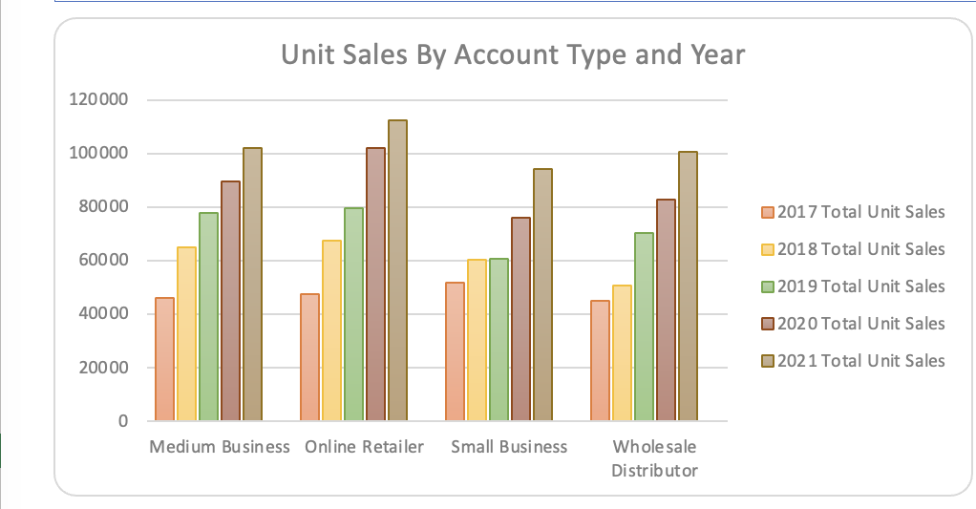
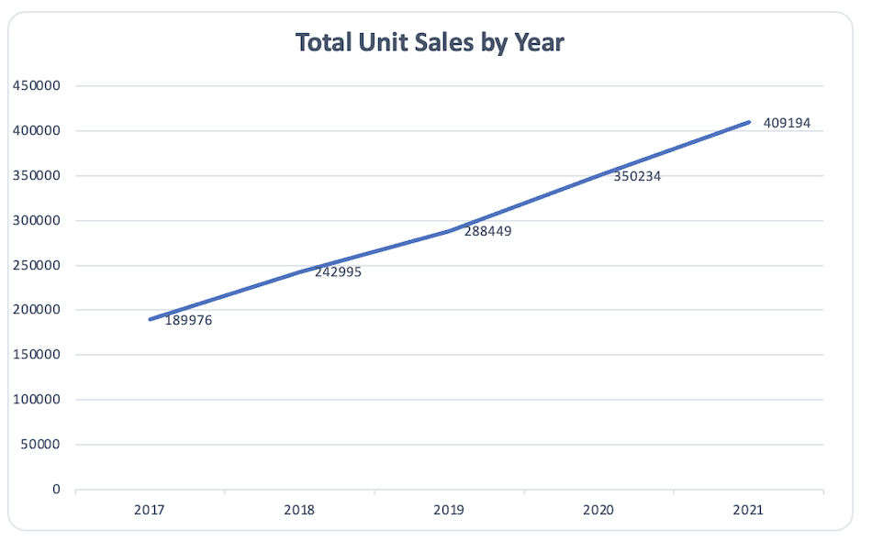
Explanation and Recommendations:
Unit Sales by Account Type and Year: The data reveals the trends in unit sales across different account types over the years. It helps identify growth patterns and potential areas of focus for sales strategies. For example, the small business (SB) accounts consistently show an upward trend, while medium business (MB) accounts exhibit steady growth. Online retailer (OR) and wholesale distributor (WD) accounts also show consistent growth, but with varying magnitudes.
Total Unit Sales by Year: The overall unit sales data highlights the growth trajectory of the business. The consistent increase in unit sales from 2017 to 2021 indicates positive market demand. However, it is essential to sustain and further accelerate this growth through targeted marketing efforts, customer retention strategies, and exploring new market opportunities.

Slide 6

Summary
Key Takeaways:
Unit sales across small business (SB), medium business (MB), online retailer (OR), and wholesale distributor (WD) accounts have shown consistent growth.
Identify and prioritize high-potential accounts to allocate resources and tailored strategies for improvement.
Optimize marketing efforts by leveraging successful programs, analyzing social media impact, and focusing on high ROI channels.
Diversify product offerings based on market trends and customer preferences.
Enhance operational efficiency through process improvements, supply chain optimization, and inventory management.
Implementing these recommendations will drive revenue growth, improve account performance, and establish a competitive edge. Regular monitoring and evaluation are essential for tracking progress and ensuring strategy effectiveness.

